Slide 1
WSN MAC Layer Strategies

Slide 2
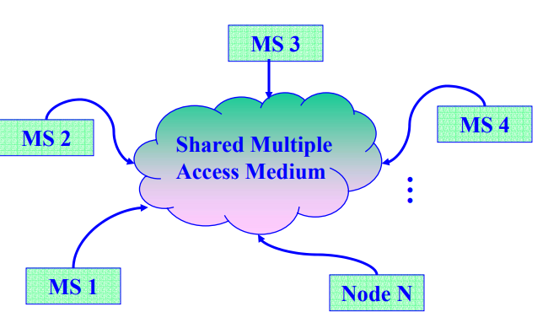
Introduction
❒ Multiple access control channels
❍ Each Mobile Station (MS) is attached to a transmitter / receiver which communicates via a channel shared by other nodes
❍ Transmission from any MS is received by other MSs in the neighborhood

Slide 3
Introduction(cont.)
❒ Multiple access issues
❍ Wireless Channel is shared among multiple neighboring nodes
❍ If more than one MS transmit at a time on the shared media, a collision occurs
❍ How to determine which MS can transmit?
Wireless Medium Access Control – Why?
❒ Access Control protocols define rules for orderly access to the shared medium
❍ Fairness in sharing
❍ Efficient sharing of bandwidth
❒ Need to avoid packet collisions at the receiver due to interference
Different Types:
Contention protocols resolve a collision after it occurs or try to avoid it.
Conflict-free protocols (e.g., TDMA, FDMA, CDMA) ensure that a collision can never occur.

Slide 4
(Cont.)
Why do we need MAC?
Wireless channel is a shared medium
Radios transmitting in the same frequency band interfere with each other
The role of MAC
Controls when and how each node can transmit in the wireless channel
Solves the contention and collision
It is an algorithm that decides who has the right to send.
Two strategies/class for MAC
Contention-based channel access
Contention-free channel access

Slide 5
MAC designing is challenging in WSN
Recourse Constraints
Signal loss in the wireless channel
Collision at the receiver’s end
Hidden and exposed terminal problems

Slide 6
Contention-Free
Contention- free MAC protocols are typically based on TDMA of the wireless medium, assuming that all the sensor nodes are time-synchronized in some way.
There is no collision.
Methods:
Polling
Strobing
Cyclic broadcast

Slide 7
Contention-Based
It is a communications protocol for operating wireless telecommunication equipment that allows many users to use the same radio channel without pre-coordination.
The "listen before talk" operating procedure in IEEE 802.11 is the most well known contention-based protocol
There is a chance of collision.
Methods:
Ideal listening
Overhearing
Collision

Slide 8
Scheduled protocols
S-MAC
T-MAC

Slide 9
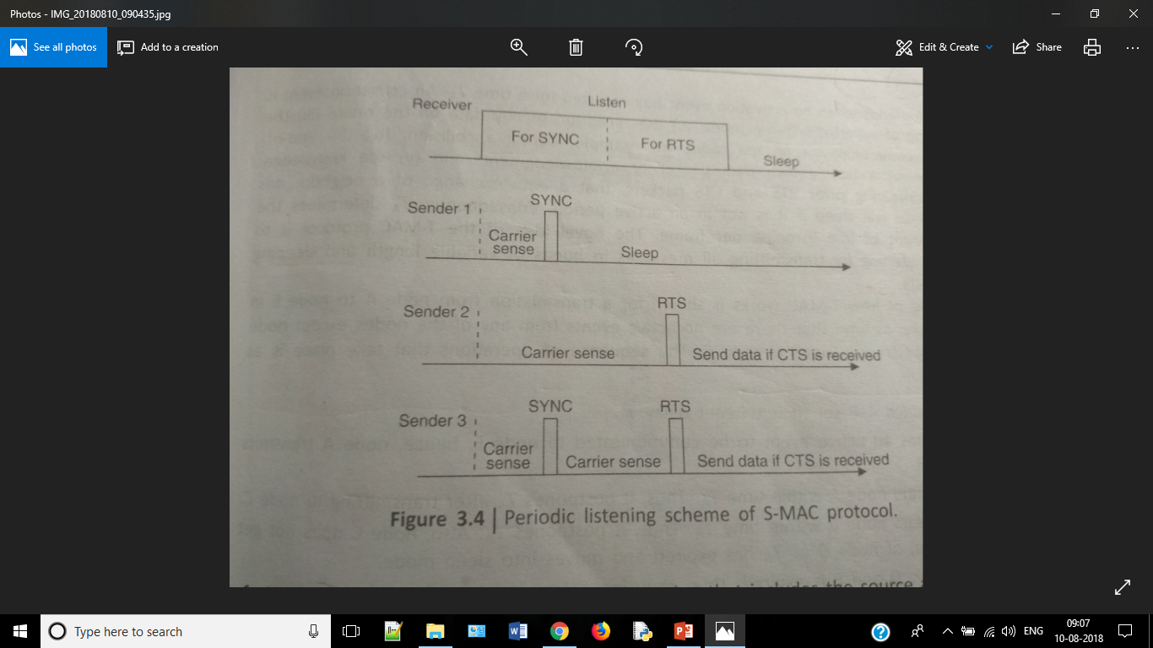

Slide 10
